Slide 1
Session 1
Software Processes

Slide 2
What is a Process … ?
When we provide a service or create a product we always follow a sequence of steps to accomplish a set of tasks
  You do not usually
    put up the drywall before the wiring for a house is installed or
    bake a cake before all the ingredients are mixed together
We can think of a series of activities as a process
Any process has the following characteristics
  It prescribes all of the major activities
  It uses resources and produces intermediate and final products
  It may include sub-processes and has entry and exit criteria
  The activities are organized in a sequence
  Constrains or control may apply to activities
  (budget control, availability of resources )

Slide 3
Software Processes
When the process involves the building of some product we refer to the process as a life cycle
Software development process – software life cycle
Coherent sets of activities for
  Specifying,
  Designing,
  Implementing and
  Testing software systems

Slide 4
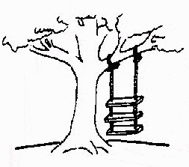



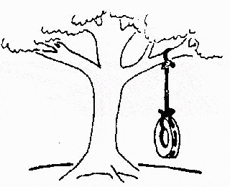
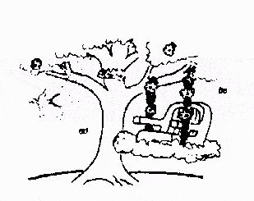
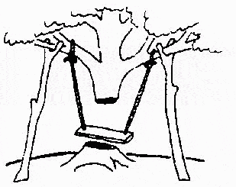
Major problems in software developments …
The requirements specification was defined like this
The developers understood it in that way
This is how the problem is solved now
This is how the problem was solved before.
This is how the program is described by marketing department
This, in fact, is what the customer wanted … ;-)
That is the program after debugging

Slide 5
The Software Process
A structured set of activities required to develop a
software system
  Specification
  Design
  Validation
  Evolution
A software process model is an abstract representation of a process
  It presents a description of a process from some particular perspective

Slide 6
Generic Software Process Models
The waterfall model
  Separate and distinct phases of specification and development
Evolutionary development
  Specification and development are interleaved
Formal systems development (example - ASML)
  A mathematical system model is formally transformed to an implementation
Reuse-based development
  The system is assembled from existing components

Slide 7
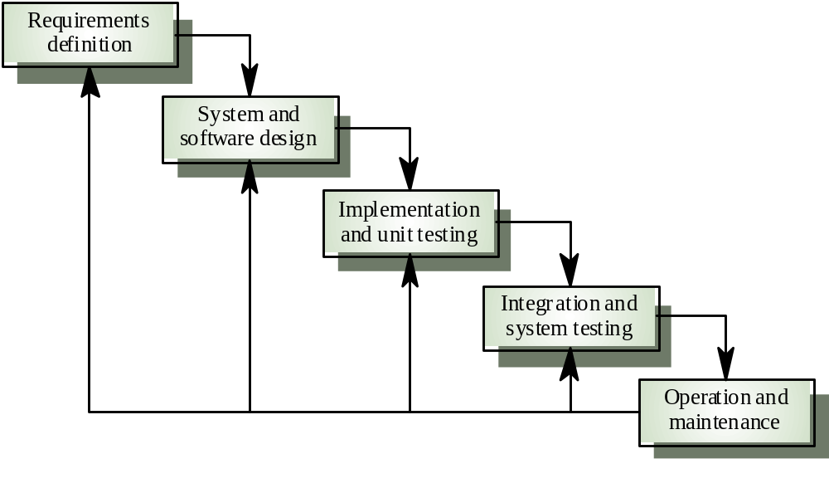
1. Waterfall Model

Slide 8
Waterfall model phases
Requirements analysis and definition
System and software design
Implementation and unit testing
Integration and system testing
Operation and maintenance
The drawback of the waterfall model is the difficulty of accommodating change after the process is underway

Slide 9

Waterfall model problems
Inflexible partitioning of the project into distinct stages
This makes it difficult to respond to changing customer requirements
Therefore, this model is only appropriate when the requirements are well-understood
Waterfall model describes a process of stepwise refinement
  Based on hardware engineering models
  Widely used in military and aerospace
  industries

Slide 10

Why Not a Waterfall
But software is different :
  No fabrication step
    Program code is another design level
    Hence, no “commit” step – software can always be changed…!
  No body of experience for design analysis (yet)
    Most analysis (testing) is done on program code
    Hence, problems not detected until late in the process
  Waterfall model takes a static view of requirements
    Ignore changing needs
    Lack of user involvement once specification is written
  Unrealistic separation of specification from the design
  Doesn’t accommodate prototyping, reuse, etc

Slide 11
2. Evolutionary development
Exploratory development
  Objective is to work with customers and to evolve a final system from an initial outline specification.
  Should start with well-understood requirements.
  The system evolves by adding new features as they are proposed by customer.
Throw-away prototyping
  Objective is to understand the system requirements. Should start with poorly understood requirements
    Develop “quick and dirty” system quickly;
    Expose to user comment;
    Refine;
  Until adequate system developed.
  Particularly suitable where:
    detailed requirements not possible;
    powerful development tools (e.g. GUI) available

Slide 12
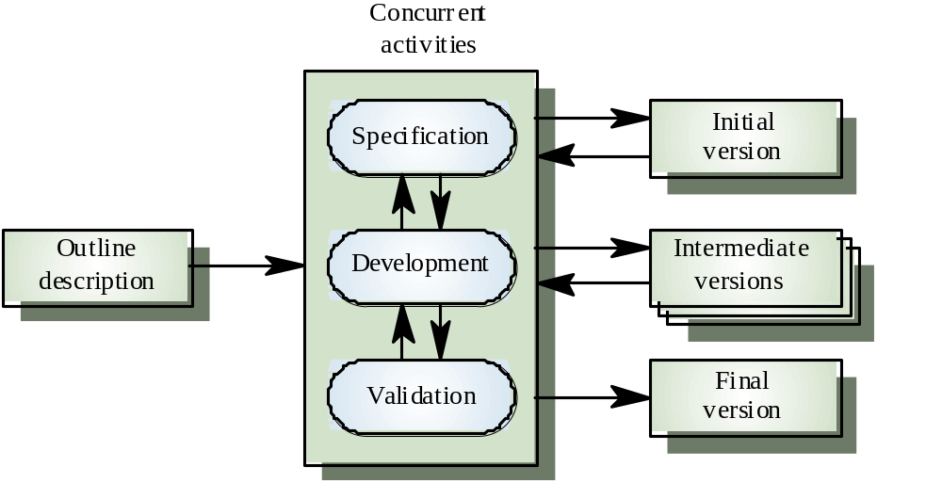
Evolutionary development

Slide 13
Evolutionary development
Problems
  Lack of process visibility
  Systems are often poorly structured
  Special skills (e.g. in languages for rapid prototyping) may be required
Applicability
  For small or medium-size interactive systems
  For parts of large systems (e.g. the user interface)
  For short-lifetime systems

Slide 14
3. Formal systems development
Based on the transformation of a mathematical specification through different representations to an executable program
Transformations are ‘correctness-preserving’ so it is straightforward to show that the program conforms to its specification
Embodied in the ‘Cleanroom’ approach (which was originally developed by IBM) to software development

Slide 15
Formal systems development

Slide 16
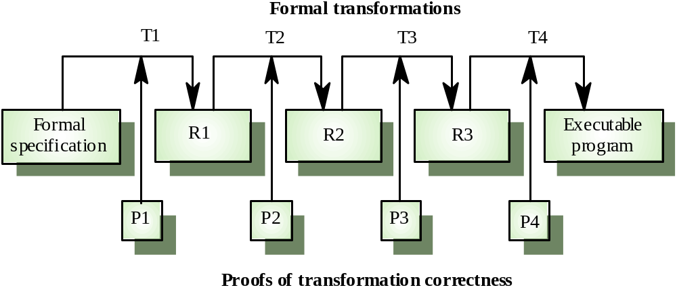
Formal transformations

Slide 17
Formal systems development
Problems
  Need for specialised skills and training to apply the technique
  Difficult to formally specify some aspects of the system such as the user interface
Applicability
  Critical systems especially those where a safety or security case must be made before the system is put into operation

Slide 18
4. Reuse-oriented development
Based on systematic reuse where systems are integrated from existing components or COTS (Commercial-off-the-shelf) systems
Process stages
  Component analysis
  Requirements modification
  System design with reuse
  Development and integration
This approach is becoming more important but still limited experience with it

Slide 19
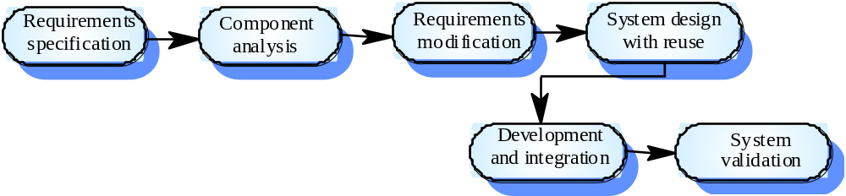
Reuse-oriented development

Slide 20
Process iteration
Modern development processes take iteration as fundamental, and try to provide ways of managing, rather than ignoring, the risk
System requirements ALWAYS evolve in the course of a project so process iteration where earlier stages are reworked is always part of the process for large systems
Iteration can be applied to any of the generic process models
Two (related) approaches
  Incremental development
  Spiral development

Slide 21
5. Incremental development
Rather than deliver the system as a single delivery, the development and delivery is broken down into increments with each increment delivering part of the required functionality
User requirements are prioritised and the highest priority requirements are included in early increments
Once the development of an increment is started, the requirements are frozen though requirements for later increments can continue to evolve

Slide 22
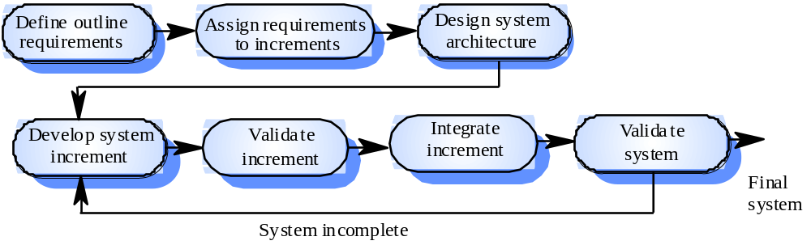
Incremental development

Slide 23

Incremental development advantages
Customer value can be delivered with each increment so system functionality is available earlier
Early increments act as a prototype to help elicit requirements for later increments
Lower risk of overall project failure
The highest priority system services tend to receive the most testing

Slide 24
Extreme programming
New approach to development based on the development and delivery of very small increments of functionality
Relies on constant code improvement, user involvement in the development team and pairwise programming
Design of the test suits first !
Then you perform testing of the system after each small increment

Slide 25
6. Spiral development
Process is represented as a spiral rather than as a sequence of activities with backtracking
Each loop in the spiral represents a phase in the process.
No fixed phases such as specification or design - loops in the spiral are chosen depending on what is required
Risks are explicitly assessed and resolved throughout the process

Slide 26
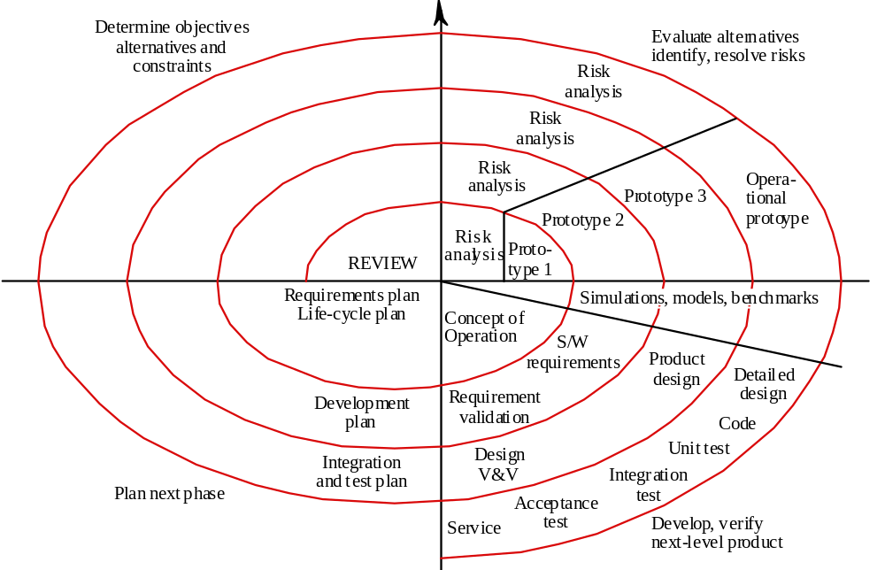
Spiral model of the software process

Slide 27
Spiral model sectors
Objective setting
  Specific objectives for the phase are identified
Risk assessment and reduction
  Risks are assessed and activities put in place to reduce the key risks
Development and validation
  A development model for the system is chosen which can be any of the generic models
Planning
  The project is reviewed and the next phase of the spiral is planned

Slide 28
I. Software specification
The process of establishing what services are required and the constraints on the system’s operation and development
Requirements engineering process
  Feasibility study
  Requirements elicitation and analysis
  Requirements specification
  Requirements validation

Slide 29
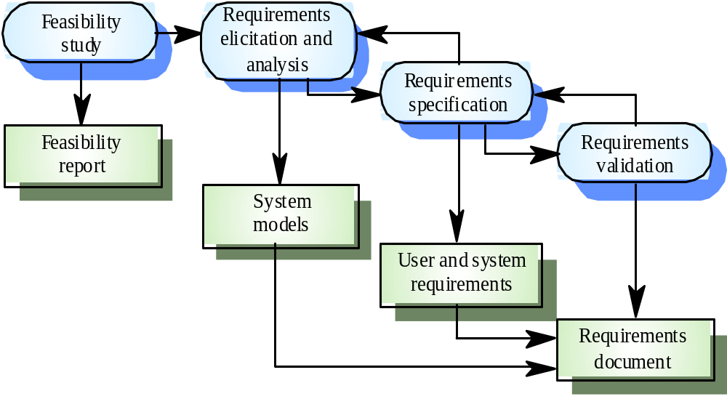
The requirements engineering process

Slide 30
II. Software design and implementation
The process of converting the system specification into an executable system
Software design
  Design a software structure that realises the specification
Implementation
  Translate this structure into an executable program
The activities of design and implementation are closely related and may be inter-leaved

Slide 31
Design process activities
Architectural design
Abstract specification
Interface design
Component design
Data structure design
Algorithm design

Slide 32
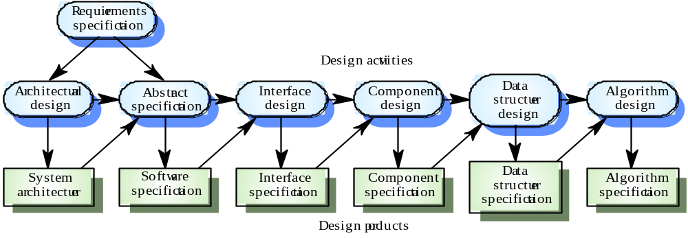
The software design process

Slide 33
Design methods
Systematic approaches to developing a software design
The design is usually documented as a set of graphical models
Possible models
  Data-flow model
  Entity-relation-attribute model
  Structural model
  Object models

Slide 34
Programming and debugging
Translating a design into a program and removing errors from that program
Programming is a personal activity - there is no generic programming process
Programmers carry out some program testing to discover faults in the program and remove these faults in the debugging process

Slide 35
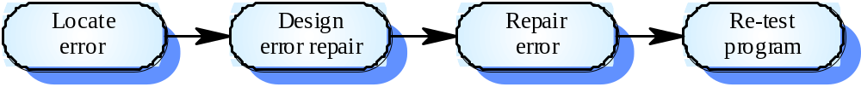
The debugging process

Slide 36
III Software validation
Verification and validation is intended to show that a system conforms to its specification and meets the requirements of the system customer
Involves checking and review processes and system testing
System testing involves executing the system with test cases that are derived from the specification of the real data to be processed by the system

Slide 37
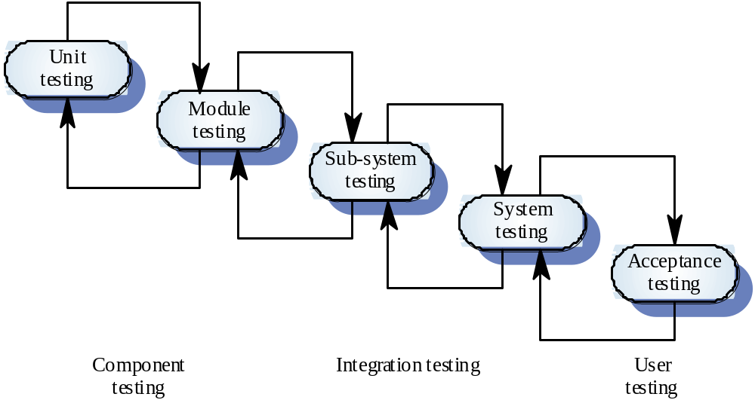
The testing process

Slide 38
Testing stages
Unit testing
  Individual components are tested
Module testing
  Related collections of dependent components are tested
Sub-system testing
  Modules are integrated into sub-systems and tested. The focus here should be on interface testing
System testing
  Testing of the system as a whole. Testing of emergent properties
Acceptance testing
  Testing with customer data to check that it is acceptable

Slide 39
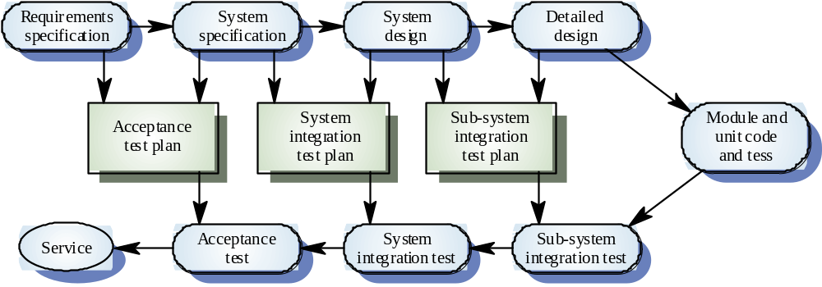
Testing phases

Slide 40
IV Software evolution
Software is inherently flexible and can change.
As requirements change through changing business circumstances, the software that supports the business must also evolve and change
Although there has been a demarcation between development and evolution (maintenance) this is increasingly irrelevant as fewer and fewer systems are completely new

Slide 41
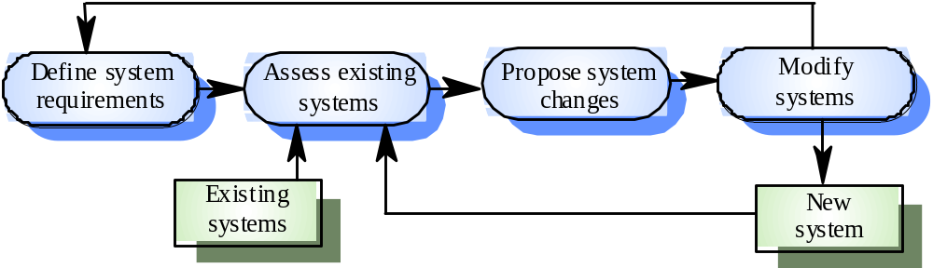
System evolution

Slide 42
Automated process support (CASE)
Computer-aided software engineering (CASE) is software to support software development and evolution processes
Activity automation
  Graphical editors for system model development
  Data dictionary to manage design entities
  Graphical UI builder for user interface construction
  Debuggers to support program fault finding
  Automated translators to generate new versions of a program

Slide 43
Case technology
Case technology has led to significant improvements in the software process though not the order of magnitude improvements that were once predicted
  Software engineering requires creative thought - this is not readily automatable
  Software engineering is a team activity and, for large projects, much time is spent in team interactions. CASE technology does not really support these

Slide 44
CASE classification
Classification helps us understand the different types of CASE tools and their support for process activities
Functional perspective
  Tools are classified according to their specific function
Process perspective
  Tools are classified according to process activities that are supported
Integration perspective
  Tools are classified according to their organisation into integrated units

Slide 45
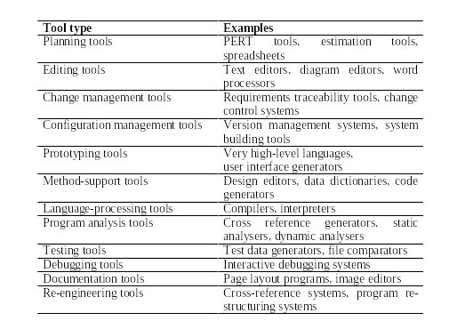
Functional tool classification

Slide 46
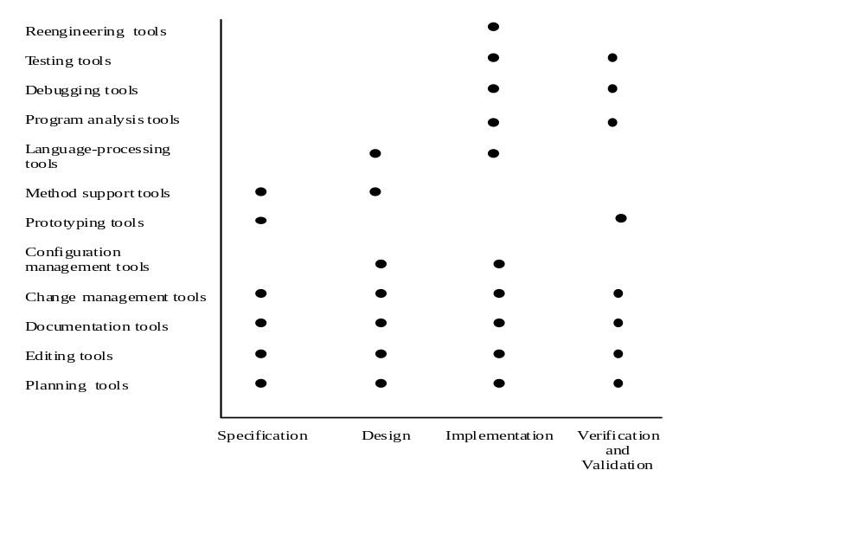
Activity-based classification

Slide 47
CASE integration
Tools
  Support individual process tasks such as design consistency checking, text editing, etc.
Workbenches
  Support a process phase such as specification or design, Normally include a number of integrated tools
Environments
  Support all or a substantial part of an entire software process. Normally include several integrated workbenches

Slide 48
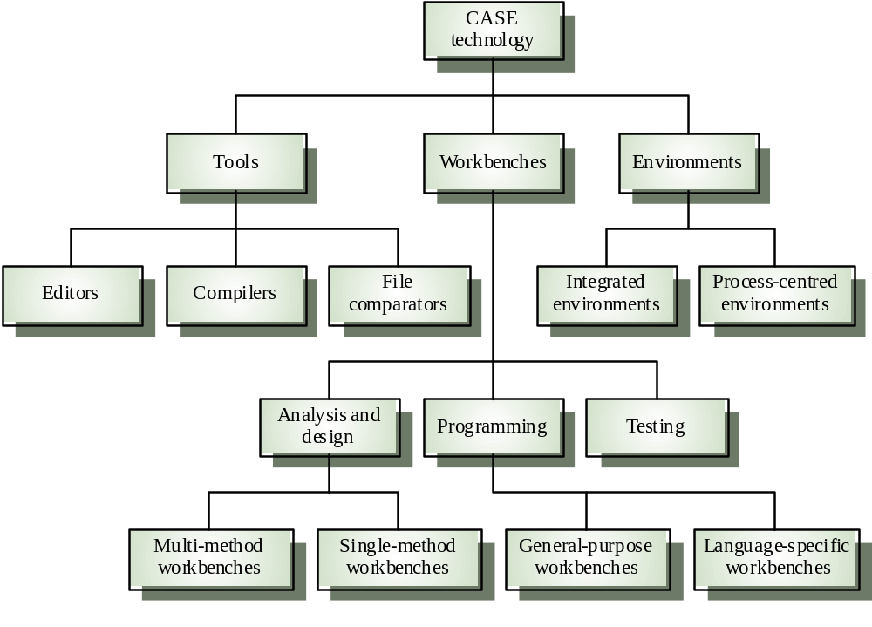
Tools, workbenches, environments

Slide 49
Key points
Software processes are the activities involved in producing and evolving a software system. They are represented in a software process model
General activities are specification, design and implementation, validation and evolution
Generic process models describe the organisation of software processes
Iterative process models describe the software process as a cycle of activities

Slide 50
Key points
Requirements engineering is the process of developing a software specification
Design and implementation processes transform the specification to an executable program
Validation involves checking that the system meets to its specification and user needs
Evolution is concerned with modifying the system after it is in use
CASE technology supports software process activities

